Slide 1

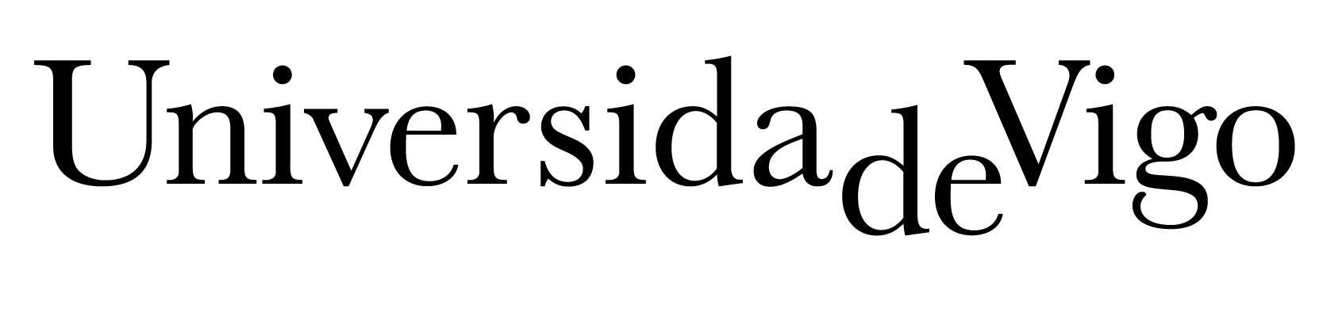

Vigo, 2 February, 2023

Slide 2
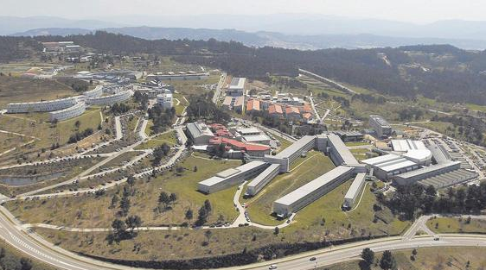
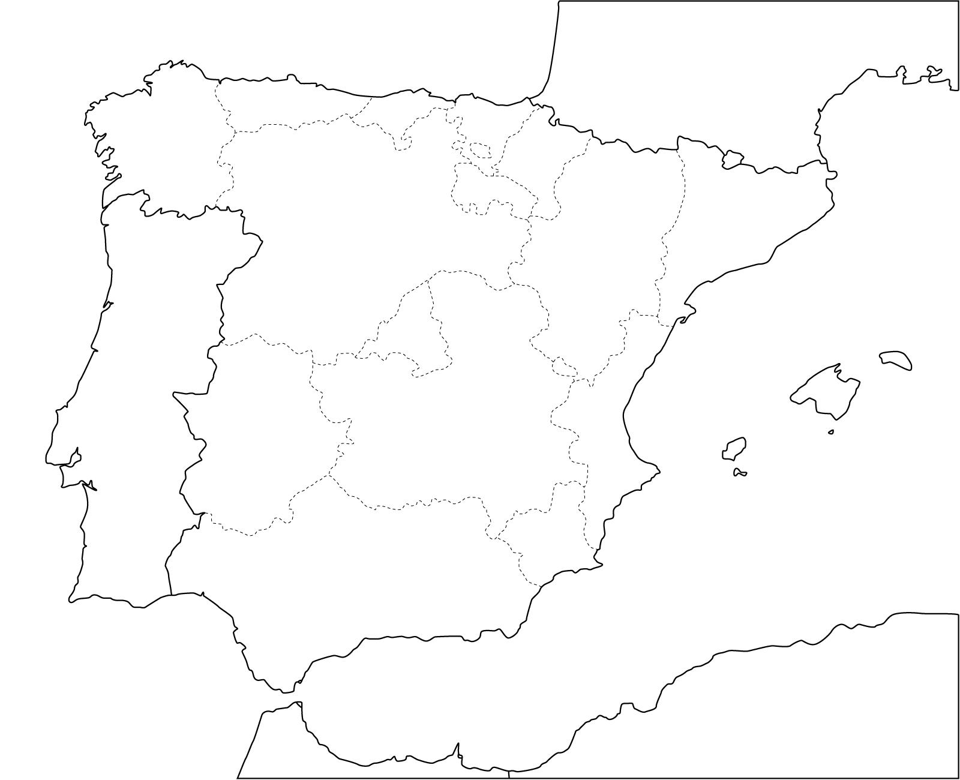
The university of the south of Galicia
The Universidade de Vigo is a Spanish public academic institution, officially founded in 1989 and located in the south of Galicia, in the Northwest of Spain.
Campus de Vigo

Slide 3
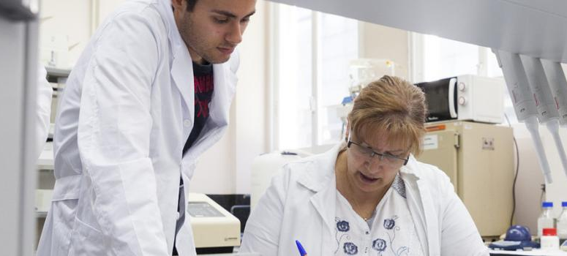

Our main objectives
1
Provide higher education services
Promote a basic and applied research
2
Transfer its knowledge and scientific advances to the society
3
Campus de Vigo

Slide 4
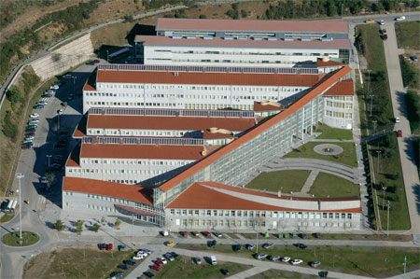
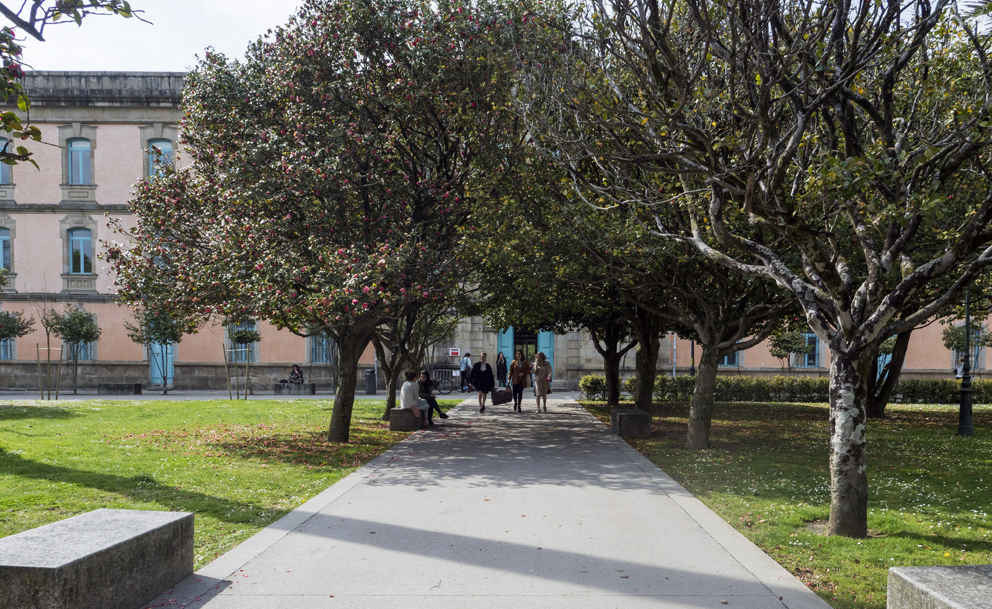
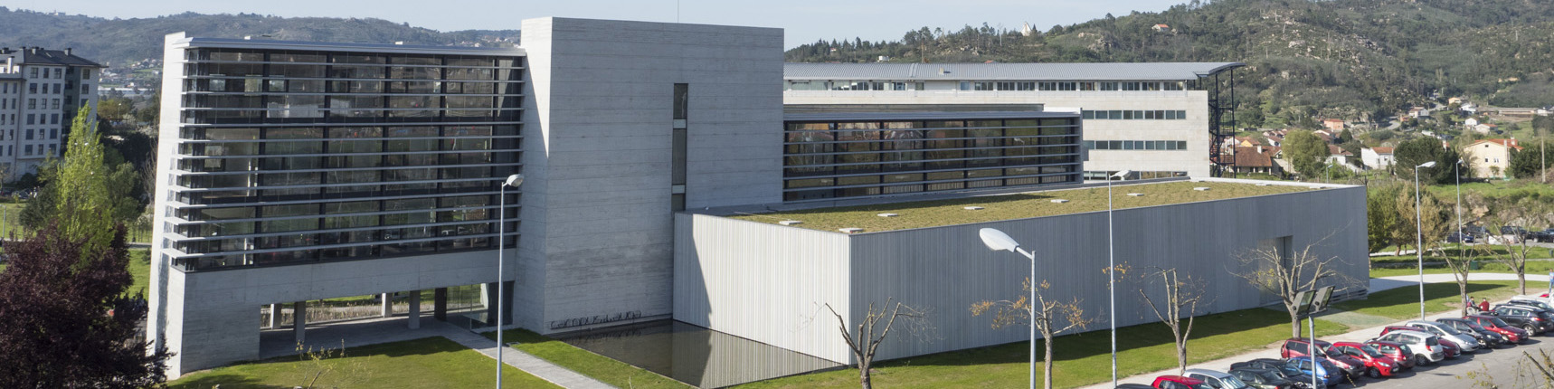
UVigo’s Campus
Campus do Mar (Vigo)
Network of research and knowledge transfer units in the field of sea science and technology.
Campus CREA (Pontevedra)
With International Green Campus flag
Campus Auga (Ourense)
Campus de Vigo

Slide 5


UVigo in numbers
22
training centers,
7 affiliated ones
+800
administration and services staff
10
research centers
6
technology centers
681
researchers
916
teaching staff
47
departments
140
areas of knowledge
Campus de Vigo

Slide 6
Knowledge Organization Group (OE7)
Founded in 1998, has played a very active role in R&D&I activities, and has collaborated in the development and analysis of Galicia's industrial competitiveness.
17
researches
4
project managers
Campus de Vigo

Slide 7
Knowledge Organization Group
Research lines
Business competitiveness and regional development
Innovation ecosystems and new business models
Global value chains in mobility
Valorization of intangible heritage
Value creation and market solutions
Corporate strategy: production, marketing, logistics and finance
Industrial networks
Campus de Vigo

Slide 8


Knowledge Organization
Group projects
This initiative arose to boost the high potential of the Euroregion Galicia-North Portugal linked to advanced mobility
(Interreg POCTEP, 2019-2022).
Aimed to identify what Intangible Cultural Heritage each participating country has, and to work with local businesses to improve their local ICH offerings
(Interreg Atlantic Area, 2019-2022)
Campus de Vigo

Slide 9
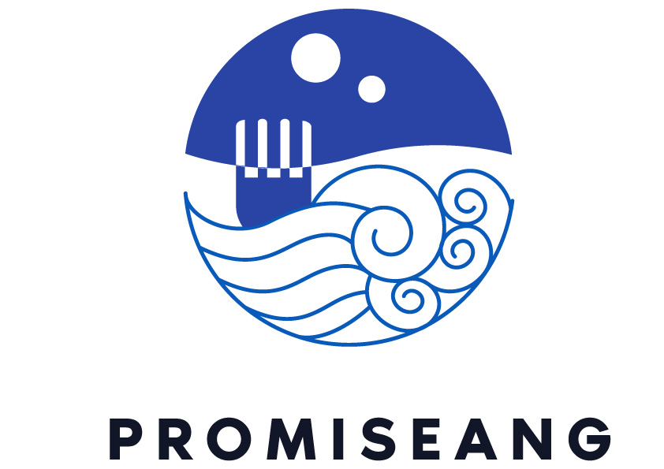

Knowledge Organization
Group projects
Focuses on entrepreneurship, innovation and knowledge transfer to convert technological capabilities into new skills to generate new products and services
(EIT HEI Initiative, 2022-2024)
Aims to expand protein supply using underexploited marine raw materials, selecting innovative organisms and applying state-of-the-art fermentation technologies
(HORIZON-JU-CBE, 2022-2026)
Campus de Vigo

Slide 10


Knowledge Organization
Group projects
Empowering local communities turning them into laboratories for co-development of circular and sustainable tourism ecosystems.
Will address the challenges of developing climate-resilient measures, paying special attention to the social, political and economic barriers, with actions implemented in at least 20 regions and communities.
(HORIZON-MISS-2022-CLIMA, 2023-2027)
Campus de Vigo

